Slide 1
SAFE-A-THON 2025 Problem Statement Release & Participant Briefing Hosted as part of IHD 2026

Slide 2
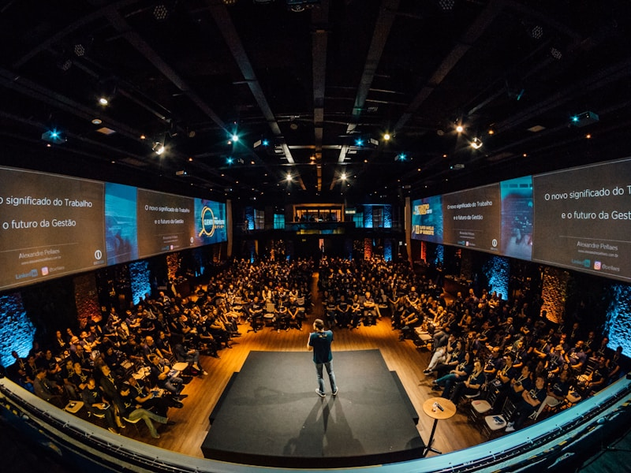
INTERNATIONAL HEALTH DIALOGUE 2026
Global Voices. One Vision.
IHD 2026 brings together the world’s most influential policymakers, global healthcare leaders, and clinicians to address the most urgent challenges in health systems. Experience breakthrough insights, collaborative problem-solving, and bold ideas that can transform care for billions.
Global Voices. One Vision.
IHD 2026 brings together the world’s most influential policymakers, global healthcare leaders, and clinicians to address the most urgent challenges in health systems. Experience breakthrough insights, collaborative problem-solving, and bold ideas that can transform care for billions.
Join us at IHD 2026 to be part of a dynamic community committed to improving lives through cutting-edge advancements and collaborative efforts.
30th & 31st January 2026, HICC - Novotel, Hyderabad

Slide 3
Safe-A-Thon 2026 Innovation • Patient Safety • Design Thinking
A national, multi-city innovation challenge to solve real-world hospital safety, operational & patient experience problems. Teams design practical, scalable solutions and present at the grand stage of
IHD 2026.
Hyderabad - Delhi - Chennai - Bengaluru - Mumbai - Ahmedabad - Kolkata - Indore - Lucknow Cochin - Guwahati - Pune

Slide 4
WHY SAFE-A-THON?
Spark system-level innovation in hospitals
Build entrepreneurial thinking in healthcare teams
Strengthen patient safety culture
Create replicable models for Safer Healthcare & beyond
Identify breakthrough ideas for national scale-up

Slide 5
WHO CAN PARTICIPATE?
Multi-disciplinary teams from hospitals
Maximum 5 members per team
Cross-functional combinations encouraged

Slide 6


SAFE-A-THON POWERED BY BIORX VENTURE GROUP
BIORx Venture Group is the official Innovation & Venture-Building Partner for Safe-A-Thon 2026, bringing:
14+ years of healthcare innovation leadership
120+ successful advisory transactions in HealthTech, MedTech, Digital Health & Life Sciences
Deep startup building expertise — 100+ startups mentored, 30+ angel investments, 40+ venture-building engagements
Indian Healthcare Angels (IHA) as the dedicated Investment Partner supporting shortlisted Safe-A-Thon teams with capital access and investor networks
VEOCAP Ventures enabling scale-up pathways for high-potential innovations
Role in Safe-A-Thon:
Structuring the national innovation pipeline
Supporting idea-to-prototype-to-pitch journey
Providing market, regulatory, and venture strategy mentorship
Preparing selected teams for exposure at the IHD/IPSC stage
WHY THIS MATTERS
This partnership ensures Safe-A-Thon is not just a competition — it is a launchpad for India’s next generation of patient-safety startups, backed by industry, investors, and clinical validation.

Slide 7
SAFE-A-THON FLOW
Team Registration
Problem Statement Release
Presentation Guidelines Release
Solution Development Phase – 05 December – 18 December 2025
Regional Jury Evaluation on 20 December
Top 3 Winners per City
National Finals at IHD 2026

Slide 8
EXPECTATIONS FROM PARTICIPANTS
Attend guidelines session
Study the problem statement deeply
Follow Safe-A-Thon template
Meet as a team regularly
Think design-first, innovation-first
Submit solution deck on or before deadline
Mandatory registration for finalists to attend IHD 2026

Slide 9
PROBLEM STATEMENT
Each problem is mapped to a key patient-safety domain
Designed to promote critical thinking
Focused on areas where system improvement is required

Slide 10
PROBLEM STATEMENT
Delays in care at various touch points and in situations
Sustainable hospitals- Energy management, Utility related & others
Zero harm (patients/staff/visitors)- a reality?
(could be focus on medication, infection, care related, or prevention of any errors)

Slide 11
WHAT MAKES A WINNING IDEA?
✔ Innovative – new way of solving a known problem ✔ Practical – doable and implementable ✔ Scalable – replicable across multiple hospitals ✔ Cost-conscious – resource-efficient ✔ Safe – enhances patient safety outcomes ✔ Entrepreneurial – market-ready potential

Slide 12
EVALUATION CRITERIA
Clarity of Problem Understanding (relevance & depth of RCA) – 20%
Innovation & Creativity – 25%
Feasibility & Implementation Readiness – 20%
Scalability Across Hospitals – 15%
Impact on Patient Safety / Experience – 20%

Slide 13
EVALUATION CRITERIA
Presentation Guidelines Release
Final Safe-A-Thon Presentation Guidelines
Including:
Format
Template
Time limits
Submission workflow
Jury panel details
Will be officially released on: 05 December 2025 at IHD website
Teams must follow only the template for final submission – 18 December 2025

Slide 14
JURY PROCESS
Regional jury (3 members) identifies Top 3 winners per city
Winners advance to IHD Finals
Distinguished National Jury evaluates finalists
Final awards announced at IHD 2026 Main Stage

Slide 15
DELIVERABLES FROM TEAMS
One solution presentation (Safe-A-Thon Format Only)
Safety risks reduced
Improved patient & staff experience
Scalable safety solutions
ZERO Harm Mission (if applicable)
Prototype/demo/mock-up (if applicable)
Costing & implementation plan
Metrics for measuring success
Final pitch (7 minutes including Q&A)

Slide 16
SUPPORT AVAILABLE ORGANIZING COMMITTEE SUPPORT
CITY | SPOC | CONTACT
HYDERABAD | Mr Vamshi | 9640624333
DELHI | Dr Sonal | 9999057977
CHENNAI | Mr Nithish | 8610643303
BENGALURU | Dr Amrut | 7406338616
MUMBAI | Mr Mukram | 7676464613
AHMEDABAD | Ms Bhumika | 7874117477
KOLKATA | Ms Jasmine | 9874920094
INDORE | Ms Shivangi | 7024533379
LUCKNOW | Dr Ankur | 7386444568
COCHIN | Ms Rubeena | 9176017070
GUWAHATI | Ms Pallabi | 8753947864
PUNE | Dr Anirudhha | 9130891088

Slide 17
Safe-A-Thon is not a competition. It is a movement. A chance to shape the future of safe, smart, efficient hospitals.
We look forward to breakthrough ideas from each team. Let the innovation begin!

Slide 18


